Slide 1
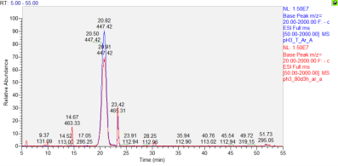
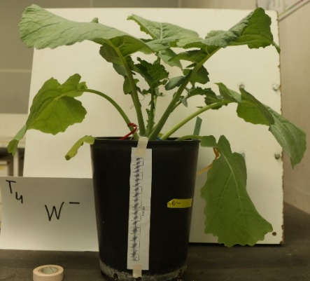
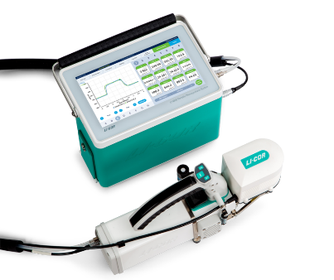
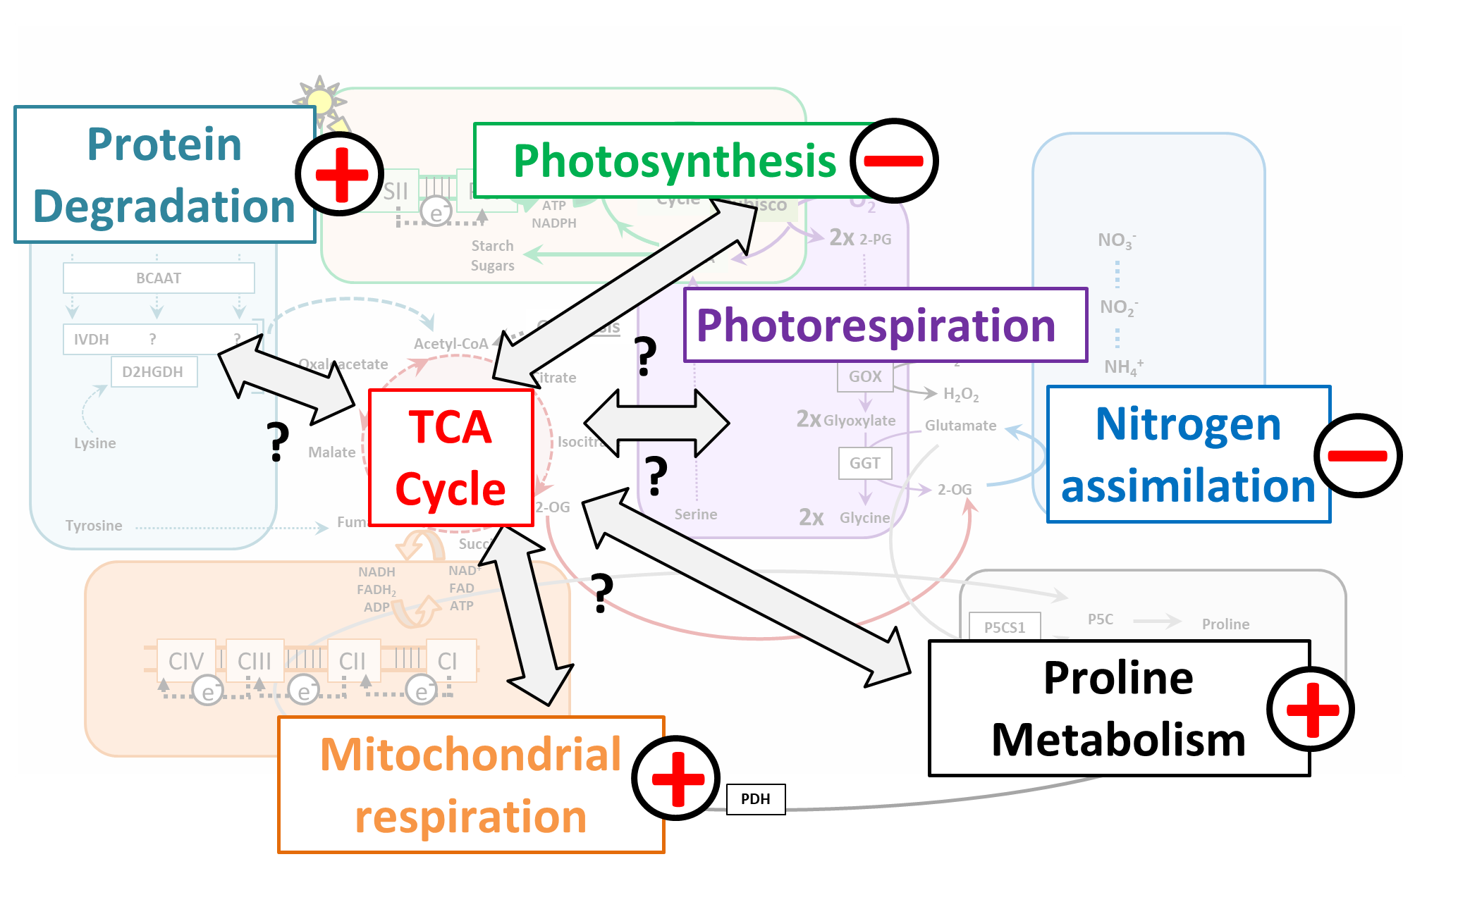
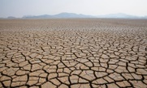
PRIMABRA: Regulation of leaf primary metabolism and sink/source relationships during acclimation to drought stress in Brassicaceae
Photo
(format carré)
Mathieu AUBERT
Espace réservé au bandeau photos
Social-economic context
Winter Oilseed Rape (OSR) is a major oleaginous crop cultivated in the world, Its seeds have important applications for human and animal nutrition, cosmetics and biofuels (seed oil and seed cake). However, its grain yield potential is threatened by global climate change, notably by drought at both vegetative and reproductive stages. While drought at the reproductive stage has a direct impact on the final seed yield, drought at the vegetative stage still remains important for grain yield establishment. Recent results from the team showed an important correlation between this autumnal biomass accumulation and the final grain yield of OSR grown under different field environments.
Funding
ARED-UR1
•
2021-2024
Scientific context
Along its crop cycle, winter OSR experiences remobilization processes between its different organs, termed sink/source relationships, and are supported by the leaf primary metabolism. In OSR grown at the vegetative stage, these nutrient remobilization processes rely on the activation of senescence in old leaves (source organ) through chloroplast degradation. Consequently, lipids and proteins from the chloroplast are remobilized through the tricarboxylic acid (TCA) cycle for mitochondrial energy production and export of both carbon and nitrogen towards very young emerging leaves (sink organs).
Sink/source relationships and leaf primary metabolism
H₂0
CO₂
Senescence
UMR IGEPP
Institute for Genetics, Environment and Plant Protection
H₂0
Leaf primary metabolism plays a key role during the progressive acclimation of OSR to drought. Indeed, the first response of OSR consists in a rapid stomatal closure to maintain cell water content, at the expense of photosynthesis and plant growth. Thus, less carbon is available for metabolic pathways, leading to an increase of carbon and nitrogen recycling processes, notably through sink/source relationships. Depending on their sink/source status and developmental stage, OSR leaves either: i) go into accelerated senescence (old leaves) to remobilize trophic resources or ii) maintain part of their metabolic activity through the accumulation of compatible osmolytes such as proline (young leaves). However, these ultimate metabolic adjustments require coordinated regulations of metabolic fluxes within leaf primary metabolism, which remained to be dissected. More specifically, the TCA cycle is expected to centralize the major regulations given its importance in both remobilization processes and proline production.
INRAE – INSTITUT AGRO RENNES-ANGERS - Université de Rennes 1
RCA
Yield Under Abiotic Challenges
Direction
Alain Bouchereau
Younès Dellero
Partners
Keywords
Brassicaceae, physiology , metabolism, drought, fluxomic
Objectives
Using the OSR cultivar AVISO, the objectives of my PhD are to:
1. Characterize the impact of drought stress on the physiological status of sink and sources leaves
2. Characterize the impact of drought stress on the tricarboxylic acid cycle in sink and source leaves
3. Model metabolic fluxes within the tricarboxylic acid cycle in sink and source leaves using ¹³C labelling approaches
4. Explore inter/intra-species variability in Brassicaceae associated with these metabolic regulations during water deficiency (comparison between different OSR varieties and different Brassica species)
54 days
18 days
2 days
0
4
8
11
15
18
Sowing
Growth
Control Drought stress
Rehydratation
Physiological characterization
Relative water content of leaves
Stomatal conductance
Chlorophyll content
Metabolic profiling
Proline, Protein, Amino Acid content
ATP/ADP and NAD(P)H/NAD(P) ratios
Enzymatic activity of TCA
¹³C- Fluxomic approach
Transient incorporations of ¹³C-metabolic probes
¹³C-Metabolic flux analysis
Results
The first results showed a progressive growth arrest of OSR under drought, characterized by a slower emergence of new leaves compared to the control condition. Further analysis showed that young leaves maintained their relative water and chlorophyll contents whereas old leaves went into an accelerated senescence, i.e. a rapid decline of their relative water and chlorophyll contents.
Overall, we developed an experimental set-up to apply a drought to OSR and identified 3 groups of leaf ranks showing contrasted responses during acclimation to drought. These groups will be used for further analyses in forthcoming experiments.
Control
Days
Days
Days
Drought
Perspectives
L = Leaf rank
The results of my PhD will provide a comprehensive overview of the role of the TCA cycle in sink and source leaves of OSR during acclimation to drought (identification of metabolic signatures, regulation of metabolic fluxes).

